Slide 1
Functions and Classes
Lecture 2

Slide 2
Agenda
Functions
Classes
Examples of classes
Encapsulation
Access specifiers
Inheritance
Single
Multilevel
Hierarchical
Multiple

Slide 3
Functions

Slide 4
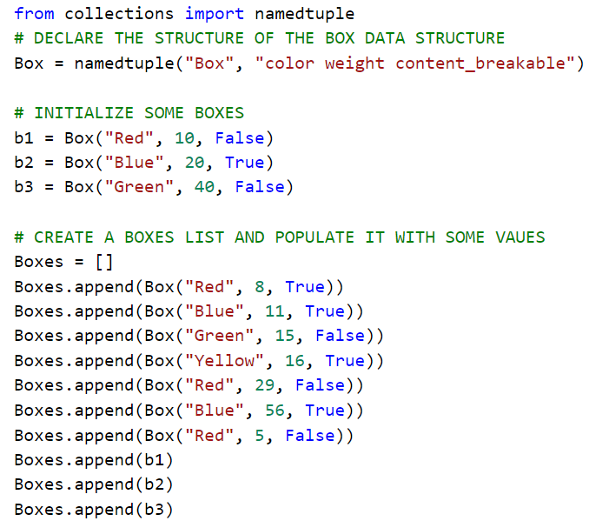

Slide 5
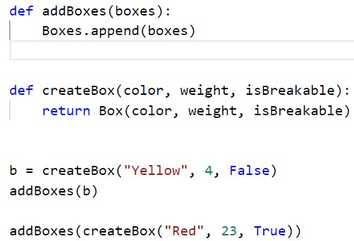

Slide 6
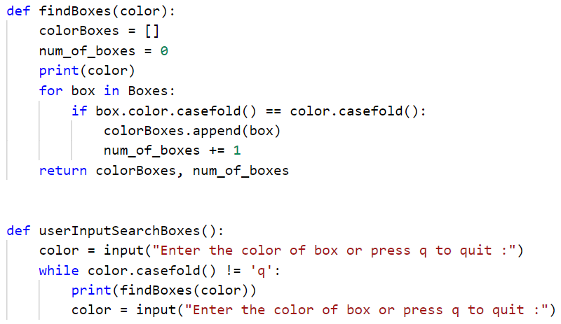

Slide 7
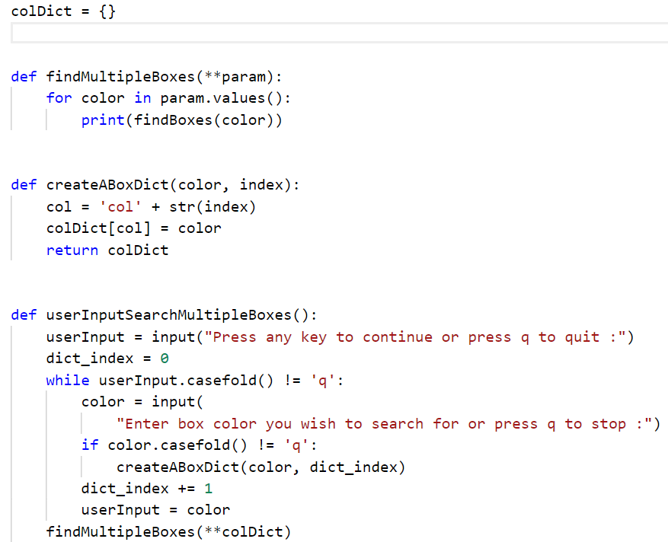

Slide 8
Classes

Slide 9
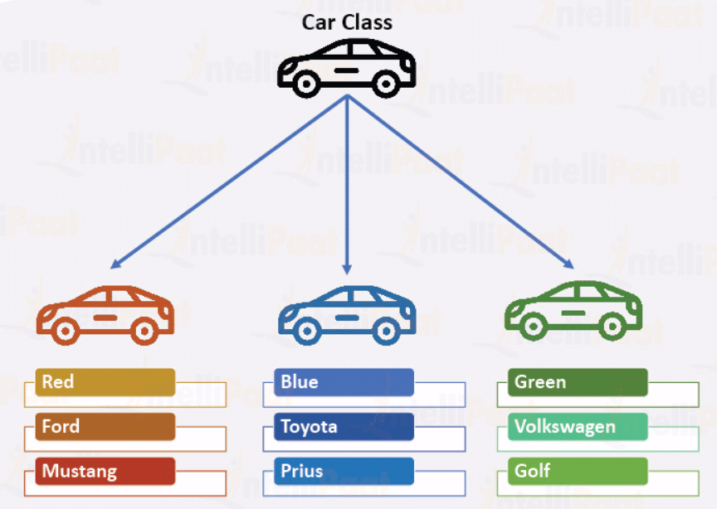
Classes are user defined data types
Containers for storing data
User (Programmer) can define them
Classes and Objects
Classes are blueprints
Objects are realization of those blue prints

Slide 10
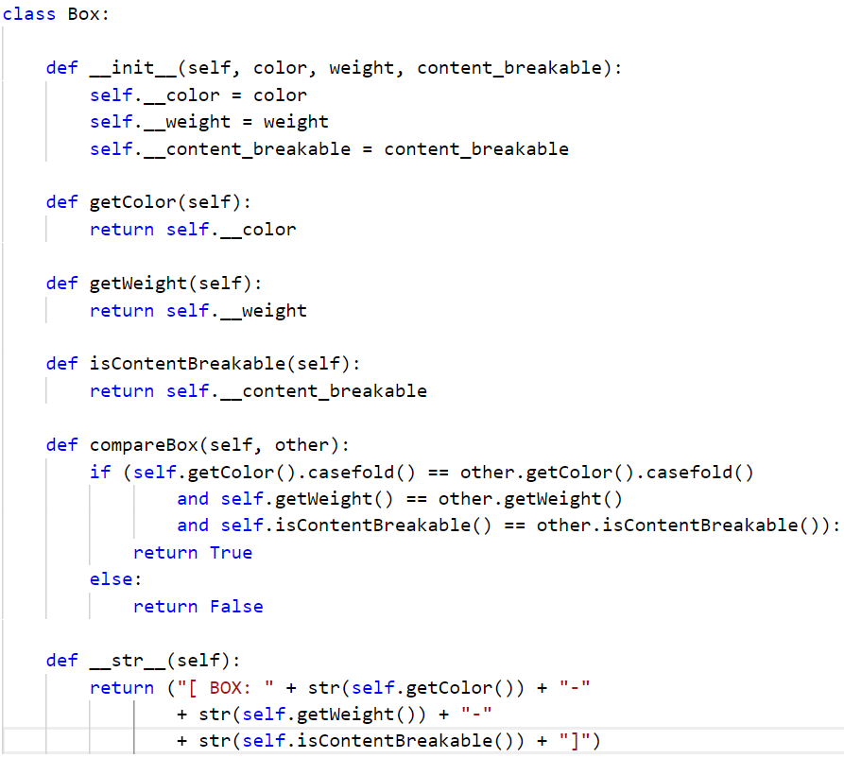

Slide 11
Access specifiers

Slide 12
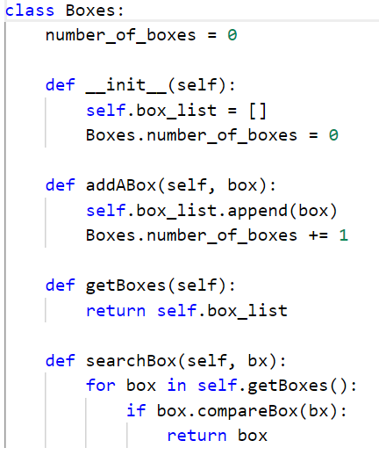

Slide 13
Inheritance
Single
Multilevel
Hierarchical

Slide 14
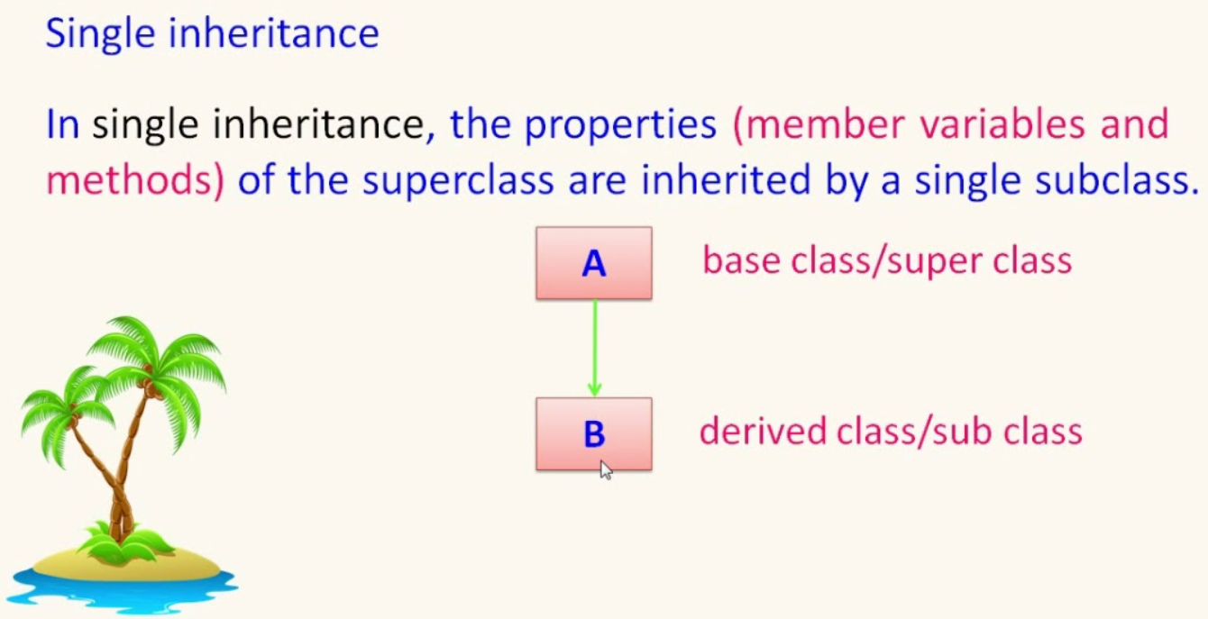

Slide 15
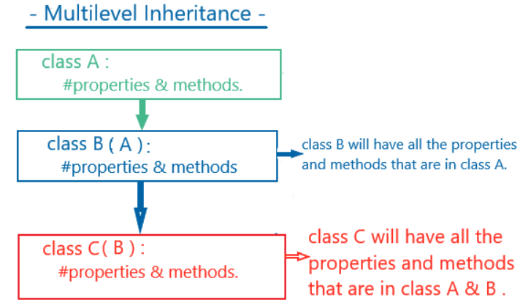

Slide 16
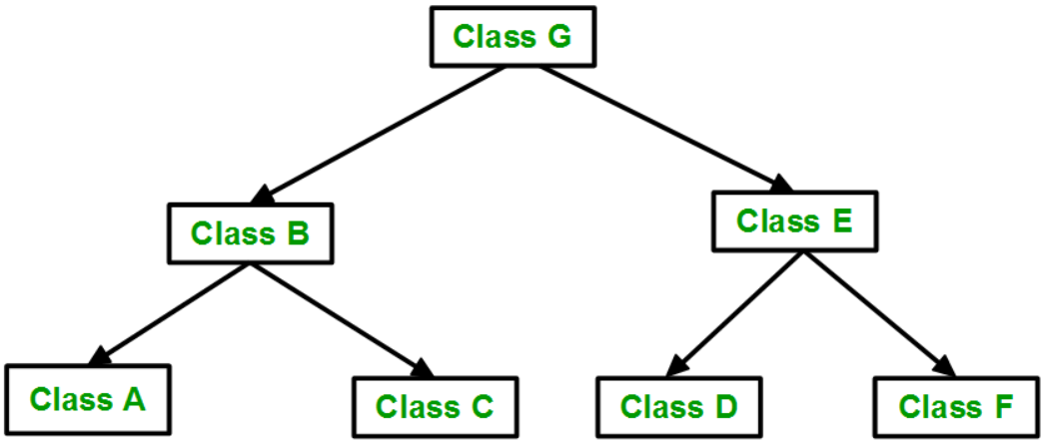
Hierarchical

Slide 17
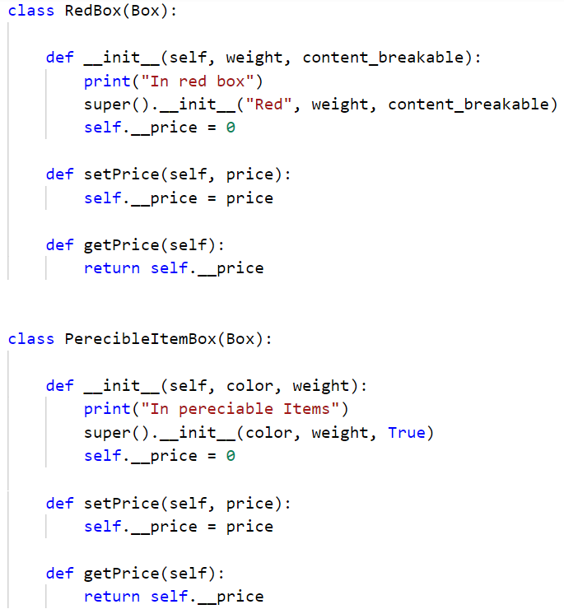

Slide 18
Multiple Inheritance

Slide 19
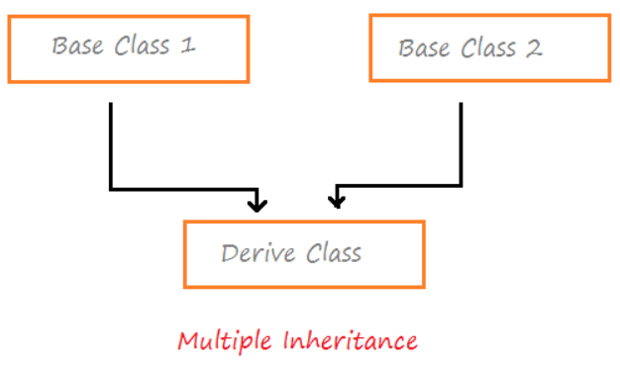

Slide 20
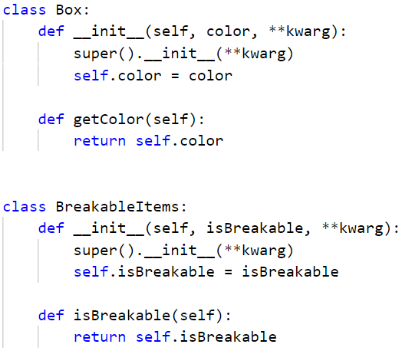

Slide 21
